Slide 1
Observation of the photocentre position variations with CoRoT - Scientific motivations and expected performance
C. Moutou (LAM) – H. Deeg (IAC) – M. Ollivier (IAS)
M. Auvergne (LESIA) – R. Diaz (LAM) – F. Bouchy (IAP) - P. Bordé (IAS)

Slide 2
Why measuring the photocentre position ?

Slide 3
Why measuring the photocentre position ?
Fastidious photometric and spectroscopic follow-up

Slide 4
Photocentre variations ?
y
+
+
x
What to do ?
What is the amplitude of the phenomenon ?
Are we able to detect it ?

Slide 5
Accuracy of the photocentre position determination
First approach : simulation “Best case” :
photon noise limited observation + no other noise sources
Measurement of photocentre position on a 32 s sampled LC
Rms over 256 points (136 min)

Slide 6
Accuracy of the photocentre position determination
Second approach : “realistic case” : Estimation of the photocenter position using the imagettes
Determination of the optimal mask for the exo target
Estimation of the photocentre position using the pixel within the mask as it is done for the sismo stars (white light)
Determination of the residual jitter thanks to the sismo stars
Correction of the jitter in the photocentre curve for the exo target
Estimation of the photocentre stability (rms of the photocentre position curve)
“clever” filtering : gain by a factor of 2 in the rms value ?
Work done for 2 targets
Star 101062850 R=15.07
Star 102797300 R=13.68

Slide 7
Accuracy of the photocentre position determination
Star 102797300 R=13.68 : rms=0.015 px -> 0.0075 px

Slide 8
Accuracy of the photocentre position determination
Star 101062850 R=15.07 rms = 0.022 px -> 0.011 px

Slide 9
Photocentre position averaging
If we average over the transit duration + several transits:
If à 80 day run
Orbital period (d) | 2 | 4 | 10 | 80
Transit duration (min) | 136 | 170 | 230 | 460
Gain | 100 | 80 | 60 | 40
Accuracy (px) | 10-4 | 1,2 x 10⁻⁴ | 1,6 x 10⁻⁴ | 2,5 x 10⁻⁴

Slide 10
Amplitude of the photocentre position variations
First approach : simulation “Best case” :
Photon noise limited observation + no other noise sources
Optimized photometric mask
1 contaminant (BBS) star at a varying distance
Several values of the extinction rate
Mean value of the photocentre over 136 min (256 frames every 32 s)
Determination of the rms with a 32 s sampling
Determination of the photocentre variation w/o eclipse of the BBS.

Slide 11
Amplitude of the photocentre position variations (ΔmV=3)
ΔF/F
0.6 %
2 %
3 %

Slide 12
Amplitude of the photocentre position variations (ΔmV=5)

Slide 13
Amplitude of the photocentre position variations
Second approach : analytic calculation
Δ_{phot} : photocentre position variation (pix)
frac_{cont} : fraction of the contaminant flux on the total flux in the aperture
F_{t}, F_{c} : target and contaminant flux
k : fraction of the contaminant flux in the target aperture
Δ_{CEB} : relative depth of the CEB eclipse
d_{t➔c} : distance target contaminant in arcsec

Slide 14
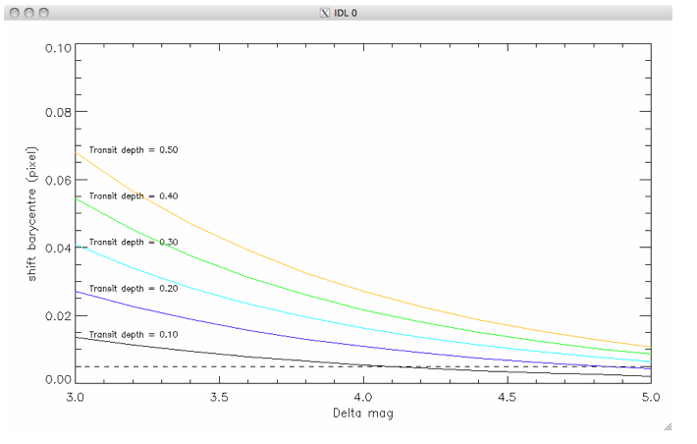
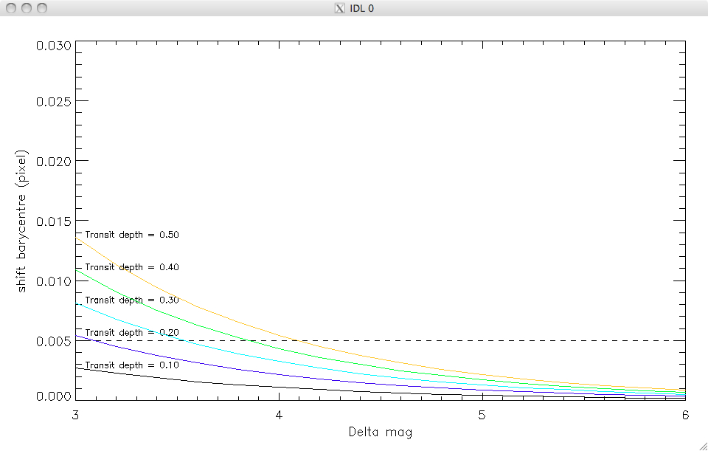
Amplitude of the photocentre position variations
Second approach : analytic calculation (k≈1)
d_{tar-BBS} = 5 arcsec
d_{tar-BBS} = 1 arcsec

Slide 15
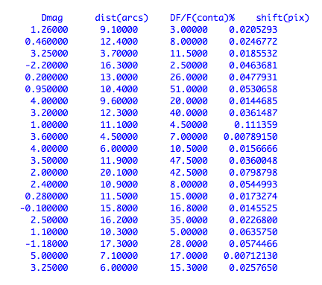
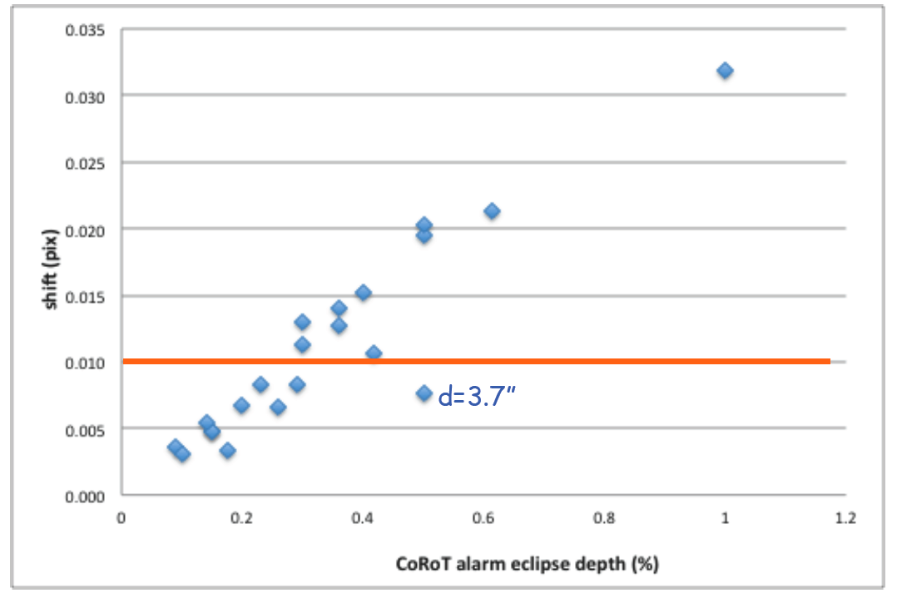
Amplitude of the photocentre position variations
Case of 21observed CEBs

Slide 16
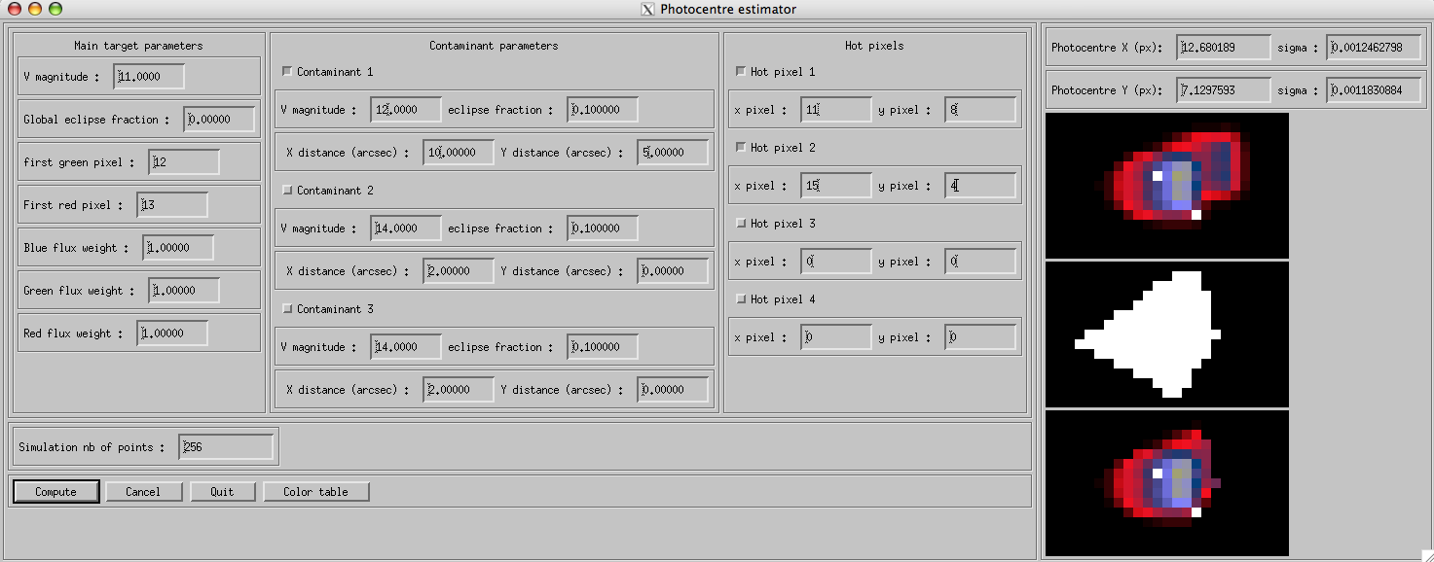
Other effect : simulation tool

Slide 17
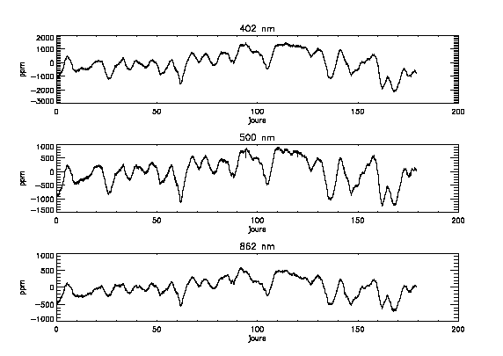
Other effect (1) : chromatic stellar flux variation
Analysis algorithms comparable to stellar flux to disentangle from stellar activity

Slide 18
Other effect (2) : main target eclipse in a crowed field
Main target : mV=11
2 contaminants : mV=14 @ 5 arcsec in x and y

Slide 19
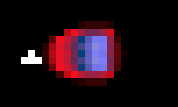
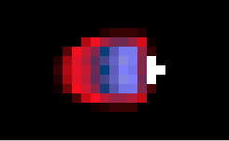
Other effect (3) : effect of hot pixels
4 saturated pixels at extreme x positions
Δx = 3 px

Slide 20
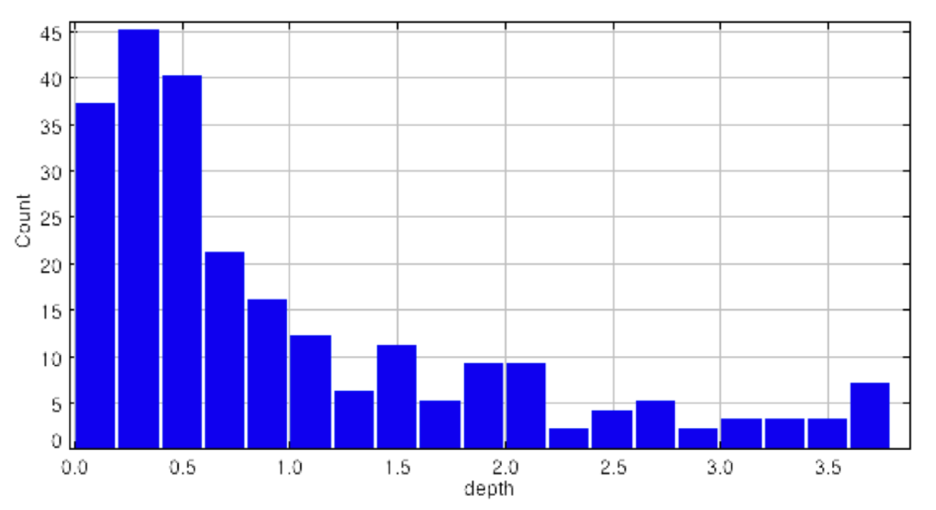
Photocentre and follow-up

Slide 21
Photocentre and follow-up
Expected from 2013-2015 runs
1000 new candidates
200 planet-like candidates (no secondary eclipse detected, shallow transit depth)
45% of them are CEBs = 90
60% of CEB lead to measurable photocentre drift

Slide 22
Conclusion
The photocentre position determination is useful for CEB identification
The accuracy appears to be sufficient at least for mR < 13-14
Other effects can be identified
The implementation strategy has to be discussed:
Modification of on-board SW to compute the photocentre position of oversampled stars
Ground base a posteriori evaluation using the imagette after re-allocation of the imagettes

Slide 23
Discussion

